Slide 1
SOFTWARE RELIABILITY AND QUALITY MANAGEMENT

Slide 2
Software Reliability
Reliability of a software product essentially denotes its trustworthiness or dependability. Alternatively, reliability of a software product can also be defined as the probability of the product working “correctly” over a given period of time.

Slide 3
It is obvious that a software product having a large number of defects is unreliable. It is also clear that the reliability of a system improves, if the number of defects in it is reduced.
Thus, reliability of a product depends not only on the number of latent errors but also on the exact location of the errors.

Slide 4
Hardware vs Software Reliability
Reliability behaviour for hardware and software are very different.
For example, hardware failures are inherently different from software failures. Most hardware failures are due to component wear and tear or a resistor might short circuit. To fix hardware faults, one has to either replace or repair the failed part. On the other hand, a software product would continue to fail until the error is tracked down and either the design or the code is changed.

Slide 5
Change in failure rate(hardware)
For hardware products, it can be observed that failure rate is high initially but decreases as the faulty components are identified and removed. The system then enters its useful life. After some time (called product life time) the components wear out, and the failure rate increases. This gives the plot of hardware reliability over time its characteristics “bath tub” shape..

Slide 6
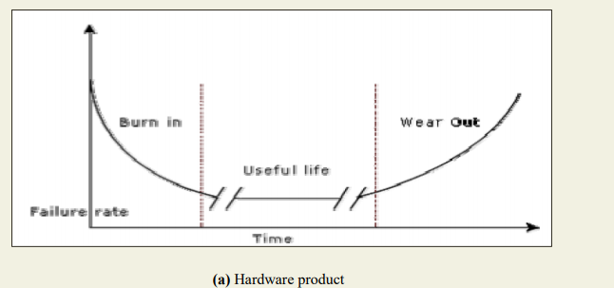

Slide 7
Change in failure rate(software)
On the other hand, for software the failure rate is at it’s highest during integration and test. As the system is tested, more and more errors are identified and removed resulting in reduced failure rate. This error removal continues at a slower pace during the useful life of the product. As the software becomes obsolete no error corrections occurs and the failure rate remains unchanged

Slide 8
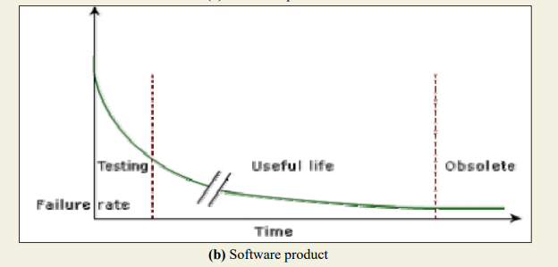

Slide 9
Reliability Metrics
There are six reliability metrics which can be used to quantify the reliability of software products.
Rate of occurrence of failure (ROCOF)- ROCOF measures the frequency of occurrence of unexpected behaviour (i.e. failures).
Eg 9/100

Slide 10

2. Mean Time To Failure (MTTF) - MTTF is the average time between two successive failures, observed over a large number of failures. To measure MTTF, we can record the failure data for n failures. Let the failures occur at the time instants t 1 , t 2 , …, t n . Then, MTTF can be calculated as

Slide 11
3. Mean Time To Repair (MTTR) - Once failure occurs, sometime is required to fix the error. MTTR measures the average time it takes to track the errors causing the failure and to fix them.
Mean Time Between Failure (MTBR) - MTTF and MTTR can be combined to get the MTBR metric:
MTBF = MTTF + MTTR.
Thus, MTBF of 300 hours indicates that once a failure occurs, the next failure is expected after 300 hours. In this case, time measurements are real time and not the execution time as in MTTF.

Slide 12
5. Probability of Failure on Demand (POFOD) - Unlike the other metrics discussed, this metric does not explicitly involve time measurements. POFOD measures the likelihood of the system failing when a service request is made. For example, a POFOD of 0.001 would mean that 1 out of every 1000 service requests would result in a failure.

Slide 13
6. Availability- Availability of a system is a measure of how likely shall the system be available for use over a given period of time
Availability=(MTBF/MTBF+MTTR)*100

Slide 14
Q what is the availability of software having Mean time between failure= 35days and mean time to repair= 7 hours?
Ans MTBF=35 days=35*24=840 hour
MTTR=7 hours
Availability=(MTBF/MTBF+MTTR)*100
Availability=(840/840+7)*100
=99.17%

Slide 15
SOFTWARE QUALITY
What is Quality?
Quality is meeting the requirement, expectation, and needs of the customer is free from the defects, lacks and substantial variants.

Slide 16
The modern view of a quality associates with a software product several quality factors such as the following:
Portability: A software product is said to be portable, if it can be easily made to work in different operating system environments, in different machines, with other software products, etc.
Usability: A software product has good usability, if different categories of users (i.e. both expert and novice users) can easily invoke the functions of the product.
Reusability: A software product has good reusability, if different modules of the product can easily be reused to develop new products.
Correctness: A software product is correct, if different requirements as specified in the SRS document have been correctly implemented.
Maintainability: A software product is maintainable, if errors can be easily corrected as and when they show up, new functions can be easily added to the product, and the functionalities of the product can be easily modified, etc.

Slide 17
What is Assurance?
Assurance is provided by organization management, it means giving a positive declaration on a product which obtains confidence for the outcome. It gives a security that the product will work without any glitches as per the expectations or requests.

Slide 18

What is Quality Assurance?
Quality Assurance is known as QA and focuses on preventing defect. Quality Assurance ensures that the approaches, techniques, methods and processes are designed for the projects are implemented correctly.
Quality Assurance has to complete before Quality Control

Slide 19
What is Control?
Control is to test or verify actual results by comparing it with the defined standards.

Slide 20
What is Quality Control?
Quality Control is known as QC and focuses on identifying a defect. QC ensures that the approaches, techniques, methods and processes are designed in the project are following correctly. QC activities monitor and verify that the project deliverables meet the defined quality standards.
It recognizes the defects. Quality Control has to complete after Quality Assurance.

Slide 21
What is The Difference in QA/QC?
Many people think QA and QC are the same and interchangeable but this is not true. Both are tightly linked and sometimes it is very difficult to identify the differences.
Fact is both are related to each other but they are different in origins. QA and QC both are part of Quality Management however QA is focusing on preventing defect while QC is focusing on identifying the defect.

Slide 22
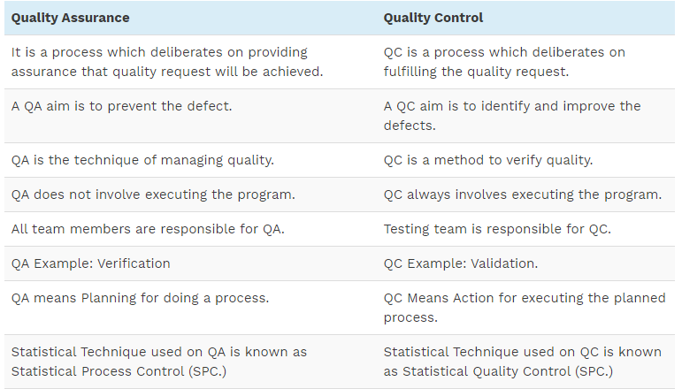
Here is the exact difference between Quality Control and Quality Assurance that one needs to know:

Slide 23
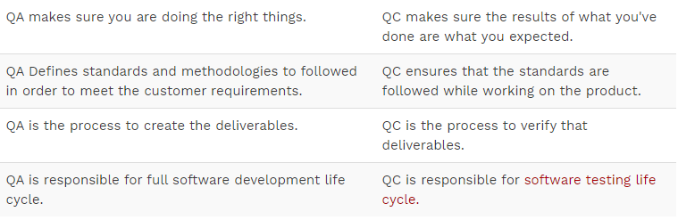

Slide 24
What is Software Quality Assurance?
Software quality assurance (SQA) is a process which assures that all software engineering processes, methods, activities and work items are monitored and comply against the defined standards. These defined standards could be one or a combination of any like ISO 9000, CMMI model, ISO15504, etc.

Slide 25
SQA Activities
1) Creating an SQA Management Plan:
The foremost activity includes laying down a proper plan regarding how the SQA will be carried out in your project.
2) Setting the Checkpoints:
The SQA team sets up different checkpoints according to which it evaluates the quality of the project activities at each checkpoint/project stage. This ensures regular quality inspection and working as per the schedule.

Slide 26
contd
3) Apply software Engineering Techniques:
Applying some software engineering techniques aids a software designer in achieving high-quality specification.
4) Executing Formal Technical Reviews:
An FTR is done to evaluate the quality and design of the prototype.
In this process, a meeting is conducted with the technical staff to discuss regarding the actual quality requirements of the software and the design quality of the prototype. This activity helps in detecting errors in the early phase of SDLC and reduces rework effort in the later phases.

Slide 27
contd
5) Having a Multi- Testing Strategy:
By multi-testing strategy, we mean that one should not rely on any single testing approach, instead, multiple types of testing should be performed so that the software product can be tested well from all angles to ensure better quality.

Slide 28
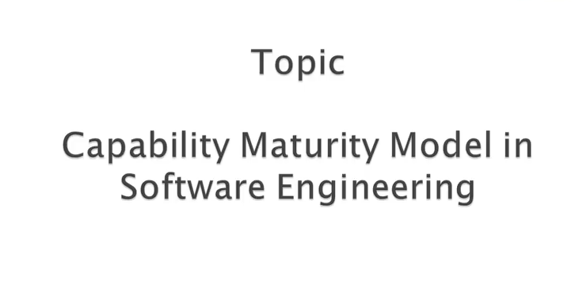
CMM MODEL

Slide 29
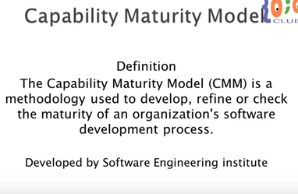

Slide 30
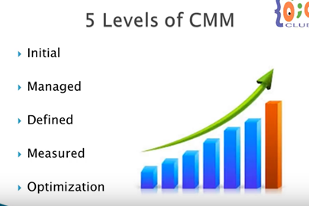

Slide 31
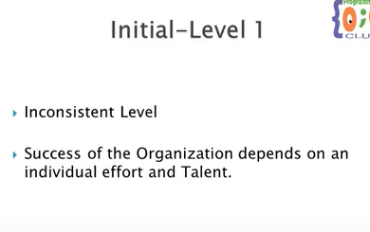

Slide 32
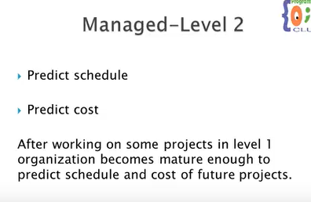

Slide 33
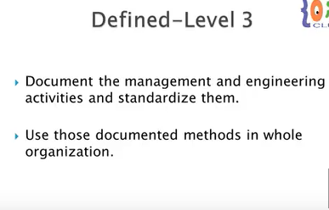

Slide 34
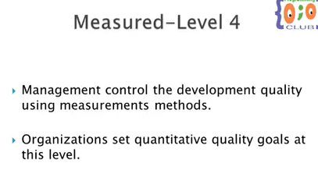

Slide 35
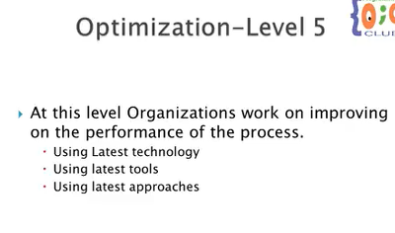

Slide 36
